Slide 1
Case Study: Bank Marketing
From : Provit Chordia

Slide 2
Content
Requirement
Overview
Data analysis
Feature Engineering
Data Modeling
Model Comparison
Conclusion

Slide 3
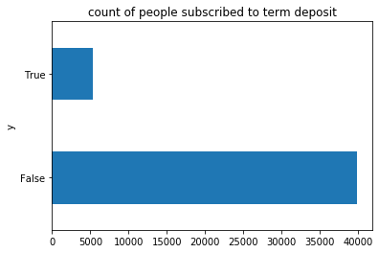
Requirement
Requirement: Finding out the factors which can help bank to increase subscription for customers, increase campaign efficiently and find high value customers.
Why?
Number of customers which has subscribed to term
insurance after marketing campaign seems to be low.
Only 13% of customers have subscribed to term
insurance out of all the marketing campaigns done.
Only 5289 customers have subscribed, and 39922
customers have not subscribed to marketing campaign.

Slide 4
Overview
How to improve campaign effectiveness?
We have: -
Dataset: Bank Marketing
Problem Category: Classification
Number of instances : 45211
Number of Attributes: 17
Categorical attributes: Job, marital, education, month, contact, poutcome(previous campaigns)
Output: Yes or No (Subscribed to term deposit or not subscribed)
Technical stack used:
Python version 3.8
Libraries: Numpy, Pandas, Matplotlib, Sklearn
Ide: Jupyter notebook

Slide 5
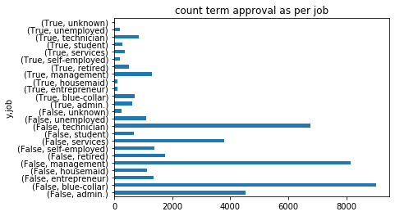
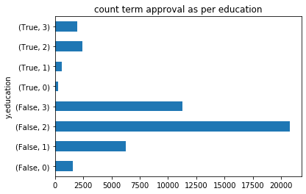
Data Analysis
Left graph shows the counts of customers contacted for term insurance w.r.t. type of job . Most of the marketing promotions have resulted in declining the offer irrespective of job.
Right graph shows the counts of people enrolled in term insurance w.r.t. level of education. Most of the people seems to have secondary education and hence most acceptance and rejection also is in secondary education.

Slide 6
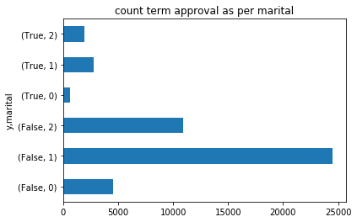
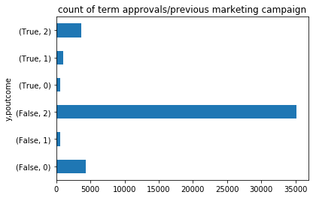
Data Analysis
Left graph shows the counts of people enrolled in term insurance w.r.t. marital status. Most people contacted were married and therefore has maximum acceptance/rejection numbers.
Right graph shows the counts of people enrolled in term insurance w.r.t. poutcome. Poutcome is the outcome of previous marketing campaigns.
It seems like most of them resulted in unknown or failed outcomes.

Slide 7
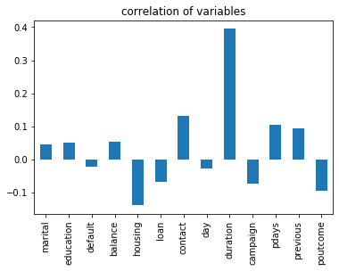
Data Analysis
Correlation between different variables with respect to output variable y. It looks like duration has highest correlation with output.
It seems that most of the people accepting offer are on call has higher duration of call. This can be understood from below stats:
Rejected offer average time 221.182806
Accepted offer average time 537.294574
Housing, loan, days and poutcome have negative correlation.

Slide 8
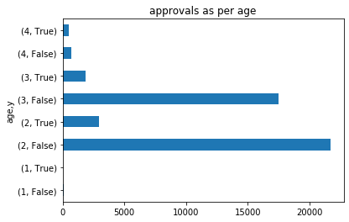
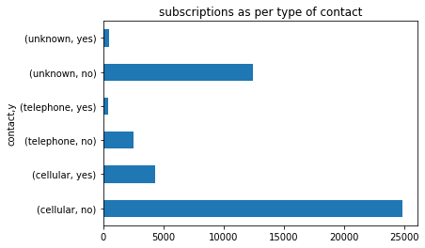
Data analysis
Above graphs shows that people buying term insurance are maximum in age group of 20-40 and then 40-60. Retired (above 60) and young people do not buy term insurance, which makes sense.
Graph on right shows that maximum people who subscribed to term deposit were contacted by cell phone. Customers with cell phones were contacted maximum.

Slide 9
Feature Engineering
From the analysis it seems that most of the columns have impact in the decision making.
Logically month is the only columns which does not have that much impact as it does not make sense for a person to buy term insurance in particular month.
Based on the analysis below data clean up / modification strategy is used so that correct model is generated with best possible prediction:-
Converted Boolean variables to True and False
Assigned numerical values to marital status and education
Bucketed age into different categories to make categorization easier
poutcome, divided into 3 categories. unknown and others are bucketed in same category.
One hot encoded job and age columns to convert to numerical data type.
Dropped month column.
Data modeling:
Data was divided in 75:25 ratio for training and testing
Data was divided using stratify method for equal class distribution in train and test.
Default hyperparameters are used.

Slide 10
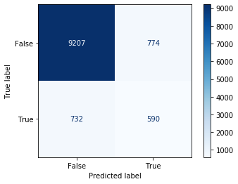
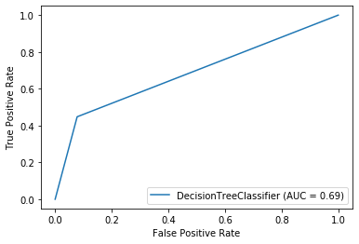
Data modeling
Decision Tree:
True negative counts are very high as compared to other buckets. This is because number of customers rejecting term deposit are lot more than subscribing.
ROC curve shows ratio of 0.69. This means there are lot more false positive (incorrectly classified) as compared to true positive.
Roc = True positive rate/ False positive rate.

Slide 11
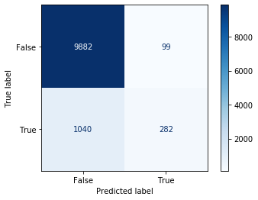
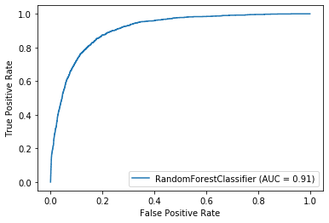
Data modeling
Random Forest
True negative counts are very high as compared to other buckets. This is because number of customers rejecting term deposit are lot more than subscribing.
ROC curve shows ratio of 0.91. Even though false positive for random forest is more (1040) but True negative also decreased and true negative increased significantly. Hence ROC ratio increased.

Slide 12

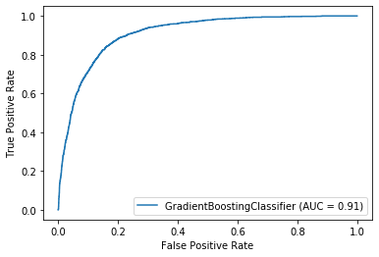
Data modeling
Gradient Boosting
Gradient boosting clearly seems to be have done better job as ratio of True positive rate against false positive rate has increased.

Slide 13
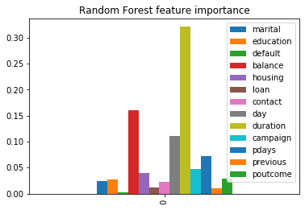

Data modeling
Looking at feature importance for 2 best model, it seems that equal weightage is given to features.
Duration followed by balance has the highest weightage in both the models.
It makes sense also as Customers which have stayed on call for longer seems to have more impact on subscription.
Also, people having high balance seems to seems to have more impact on subscription.

Slide 14
Model Comparison
 | Decision Tree | Random Forest | Gradient boosting
accuracy | 0.8667610368928603 | 0.8992302928426081 | 0.9012651508449084
Precision | 0.44780635400907715 | 0.2133131618759455 | 0.3653555219364599
Recall | 0.4327485380116959 | 0.7401574803149606 | 0.6355263157894737
Time to train | 0.1950829029083252 | 1.8188140392303467 | 3.704415798187256
Random forest and Gradient boosting have almost similar accuracy, However time taken to train Gradient boosting seems to be double of Random Forest.
By tuning hyper parameters or using techniques like GridSearch best parameters can be found for Random Forest and may be accuracy can be improved.

Slide 15
Conclusion
Duration has high impact on customer subscribing to term insurance, but it may not be a reliable conclusion for people subscribing as more duration of call can be due to different reasons.
Balance seems to have high impact on customer subscribing to term insurance.
Balance is higher as age increases which seems to be logical.
Other important features which makes impact are campaign, housing and education.
Both the best performing models indicated similar feature importance.
It is clear indication, that a person who is well to do and will settled has higher chances of buying term insurance.
Bank should target customers which maintain good balance and are well to do for subscription to term insurance.

